Slide 1


CSE 848 Artificial Intelligence ( Autoregressive Models)
Prof. Dr. Yasar Ayaz
(Pride of Performance)
Chairman / Central Project Director
National Center of Artificial Intelligence (NCAI)
Pakistan
Professor & Founding Head
Department of Robotics & AI
NUST-SMME

Slide 2
Traditional Models Fall Short
Traditional models fail for tasks involving sequences because
Accept fixed input sizes
No mechanism to retain past data
Poor performance on time-series or text data
Motivation for models with memory.
Language is sequential
Contextual understanding is key
Need memory of previous inputs

Slide 3

Simple Neural Network
Simple neural network

Slide 4
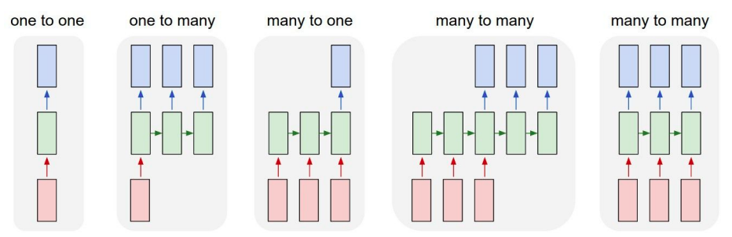
Process Sequences
In machine learning, especially with sequential models, a process sequence usually refers to the order in which data points occur
A process sequence is a chain of events or steps that must happen in a specific order to achieve a goal.
e.g. Image Captioning
image -> sequence of words

Slide 5
Process Sequences
e.g. action prediction
sequence of video frames -> action class

Slide 6
Process Sequences
E.g. Video Captioning
Sequence of video frames -> caption

Slide 7
Process Sequences
e.g. Video classification on frame level

Slide 8
Recurrent Neural Network (RNN)
RNNs contain a recurrent layer (or cell) that is able to handle sequential data by making its own output at a particular timestep form part of the input to the next timestep.

Slide 9
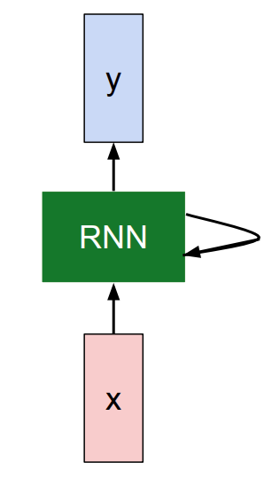
Recurrent Neural Network (RNN)
Usually want to predict a
Vector at some time step
Key idea: RNNs have an “internal state”
that is updated as a sequence
is processed

Slide 10
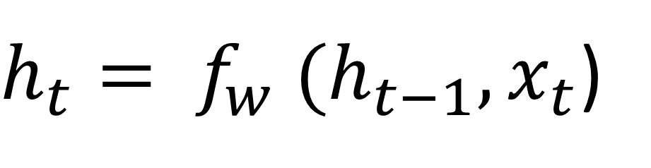
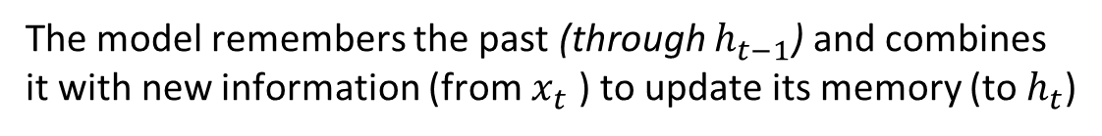
RNN hidden state update
We can process a sequence of vectors x by applying a recurrence formula at every time step:
$h_{t}= f_{w} (h_{t−1}, x_{t}$)
new state
Input vector at
some time step
old state
some function
with parameters W
The model remembers the past (through $h_{t−1}$) and combines
it with new information (from $x_{t}$ ) to update its memory (to $h_{t}$)

Slide 11
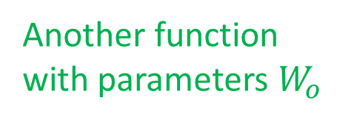
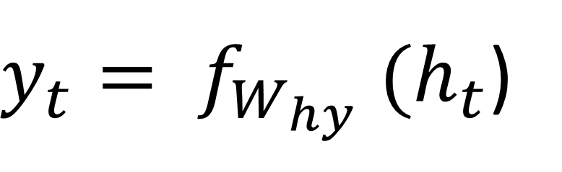
RNN output generation
We can process a sequence of vectors x by applying a recurrence formula at every time step:
$y_{t}= f_{W_{hy}} (h_{t}$)
output
Another function
with parameters $W_{o}$
new state
A time step in an RNN refers to a single point in a sequence —basically, one slice of input at one moment in time.

Slide 12
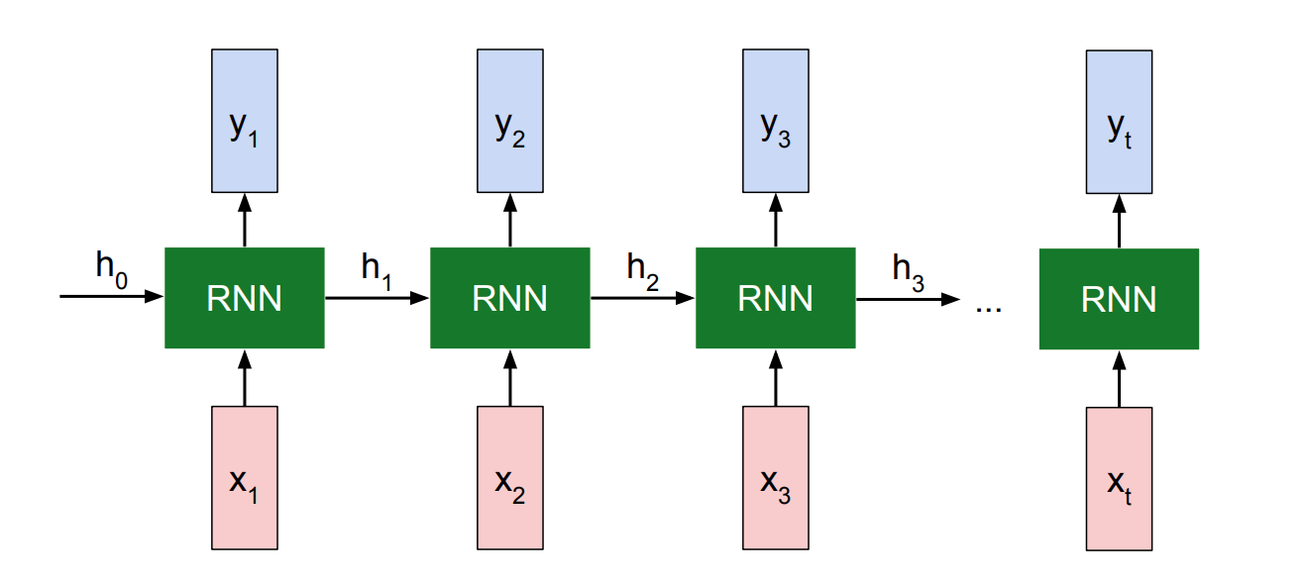
Recurrent Neural Network

Slide 13
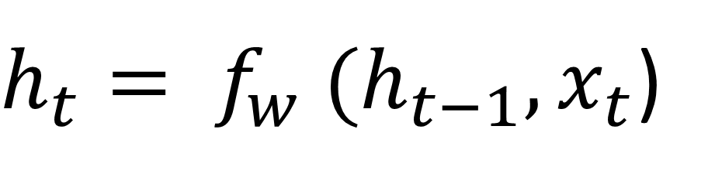
Recurrent Neural Network
We can process a sequence of vectors
x by applying a recurrence formula
at every time step:
$h_{t}= f_{w} (h_{t−1}, x_{t}$)
Notice: the same function and the same set of parameters are used at every time step.

Slide 14
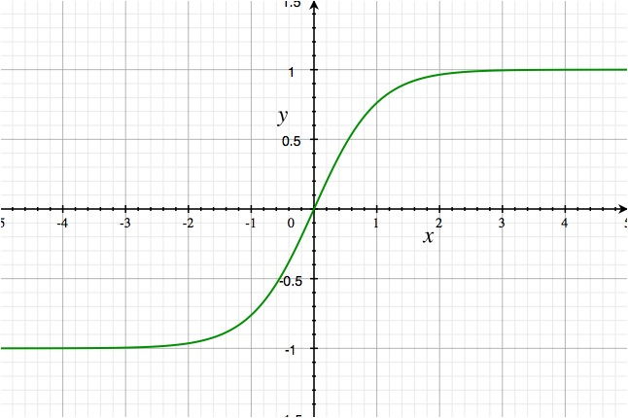
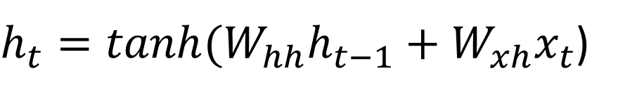
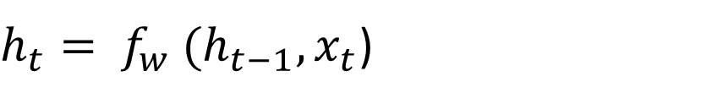

(Vanilla) Recurrent Neural Network
The state consists of a single “hidden” vector h:
$h_{t}= f_{w} (h_{t−1}, x_{t}$)
$h_{t}=tanh(W_{hh}h_{t−1}+{W_{xh}x}_{t}$)
$$y_{t}= W_{hy} h_{t}$$
tanh is used in RNNs to squash values between -1 and 1, keeping hidden states stable and centered around zero. It adds non-linearity, allowing the RNN to learn complex patterns across time steps.

Slide 15
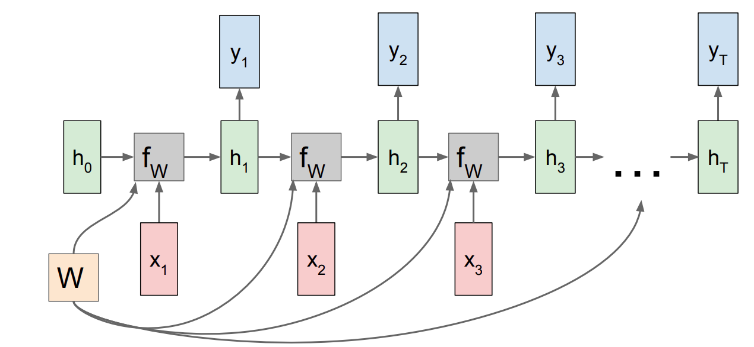
RNN: Computational Graph
Re-use the same weight matrix at every time-step

Slide 16
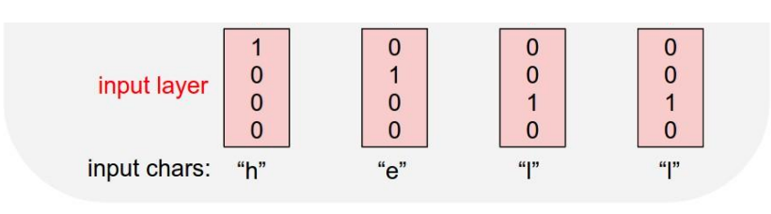
Example
Character-level
Language Model
Vocabulary: [h,e,l,o]
Example training
sequence:
“hello”

Slide 17
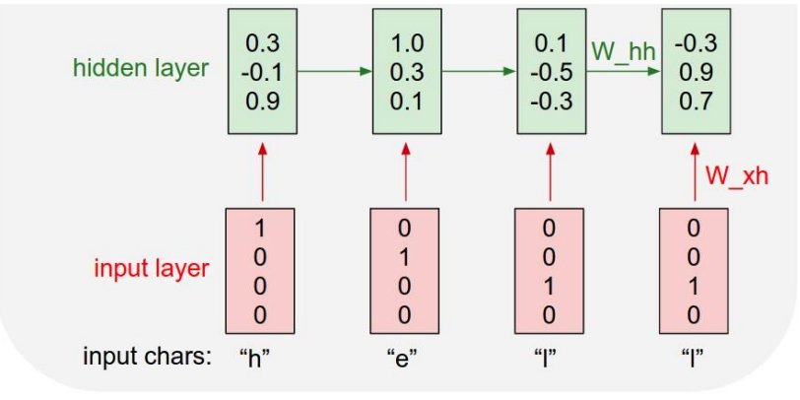
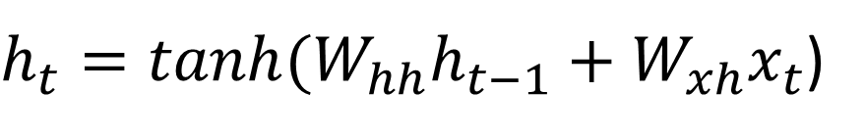
Example
Character-level
Language Model
Vocabulary: [h,e,l,o]
Example training
sequence:
“hello”
$h_{t}=tanh(W_{hh}h_{t−1}+{W_{xh}x}_{t}$)

Slide 18
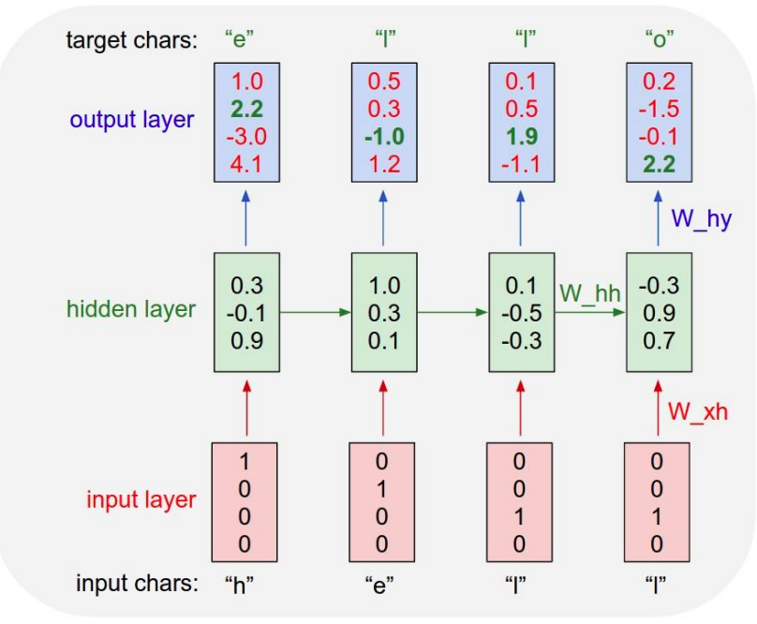
Example
Character-level
Language Model
Vocabulary: [h,e,l,o]
Example training
sequence:
“hello”

Slide 19
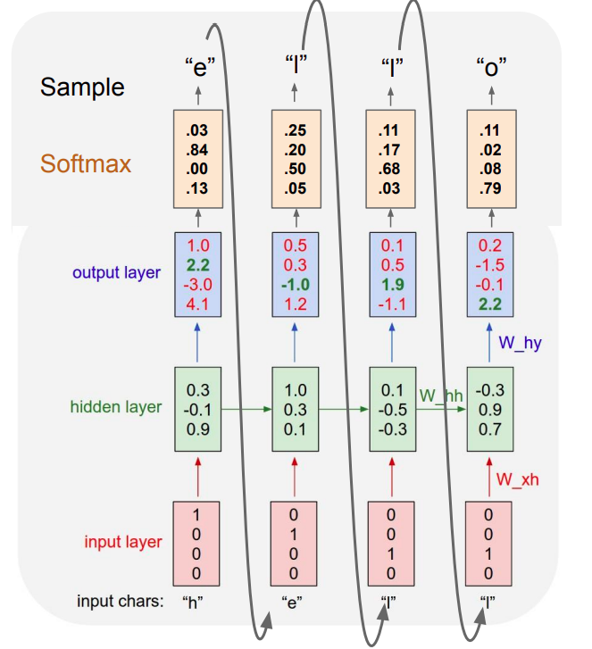
Example
Character-level
Language Model
Vocabulary: [h,e,l,o]
At test-time sample characters
one at a time, feed back to model

Slide 20
Limitation
RNNs are great, but they have problems:
Vanishing gradients: Hard to learn long-term dependencies.
Training can be slow.
Short memory: They tend to "forget" things from far back in the sequence.
Vanishing gradients is a problem during training where gradients (used to update weights) become very small as they are backpropagated through layers or time steps. This causes early layers (or earlier time steps in RNNs) to learn very slowly or not at all, making it hard to capture long-term dependencies.

Slide 21
Long Short-Term Memory Network (LSTM)
An LSTM is a special kind of RNN that’s really good at remembering things for a long time. It's designed to solve the problem of RNNs forgetting important information as the sequence gets longer.

Slide 22
How does an LSTM work?
Each LSTM unit has three gates:
Forget Gate – decides what info to throw away
Input Gate – decides what new info to add
Output Gate – decides what to send as output
It also keeps a cell state (a kind of long-term memory).

Slide 23
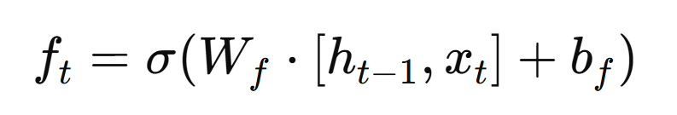
Forget Gate
"What part of the past should I forget?"
It takes the previous hidden state and the current input.
Outputs a number between 0 and 1 for each value in the cell state.
0 = forget completely
1 = keep entirely
[hₜ₋₁, xₜ]: concatenated input and previous hidden state
W_f: weight matrix for the forget gate
b_f: bias
Output values between 0 and 1 (0 = forget, 1 = keep)

Slide 24
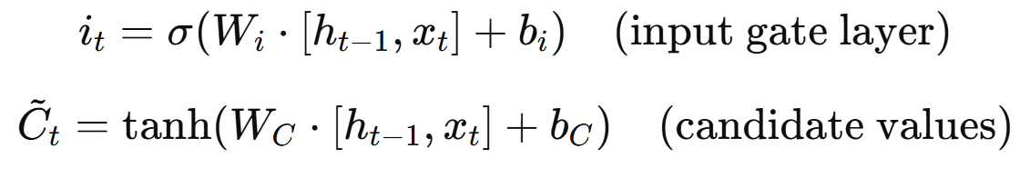
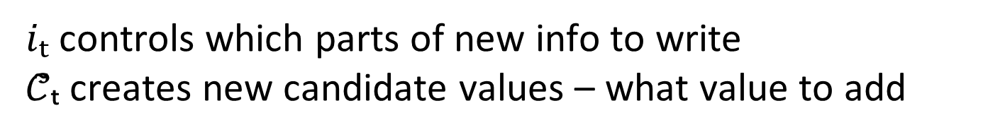
Input Gate
"What new information should I add?“
It has two parts:
A sigmoid layer decides which values to update.
A tanh layer creates new candidate values to add.
$iₜ$controls which parts of new info to write
𝒞̃ₜ creates new candidate values – what value to add

Slide 25
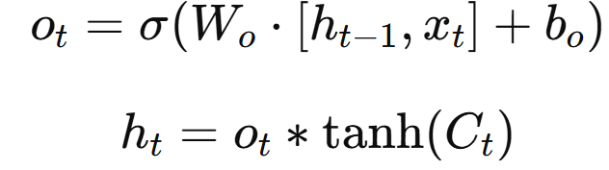
Output Gate
"What should I output?"
This gate decides what the hidden state ℎ𝑡​ (output of the cell) should be.
It uses the updated cell state and filters it through a tanh + sigmoid combination.
oₜ controls what part of the memory to output
tanh(Cₜ) squashes the cell state
Final output is hₜ

Slide 26
Reading Assignment
Chapter 5 – Autoregressive Models
Learn why autoregressive models are well suited to generating sequential data.
Learn how to process and tokenize text data.
Learn about the architectural design of long short-term memory network (LSTM).

